Slide 1

Converging magnetic systems in CP2K:
from bulk Ni to a Ni slab in vacuum
Christian Ahart

Slide 2
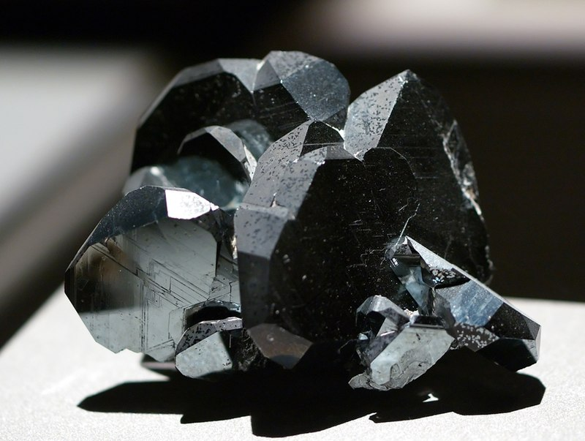
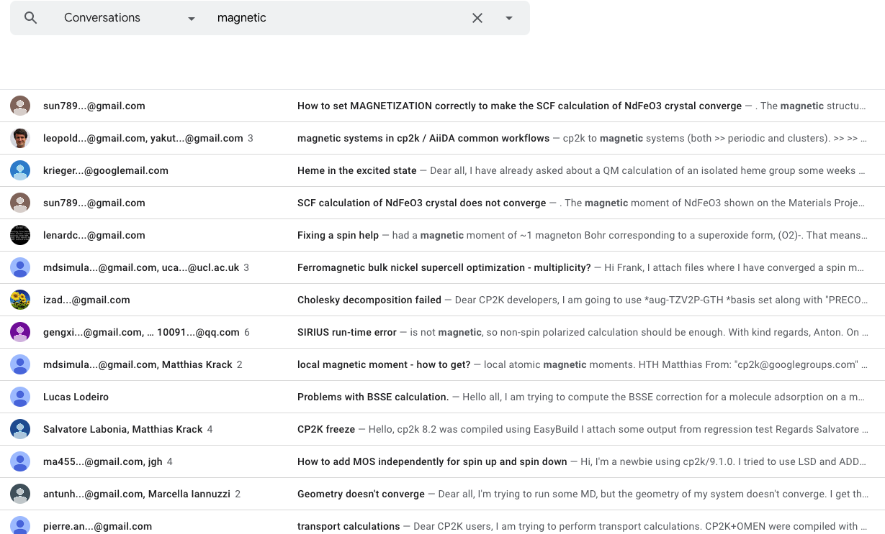
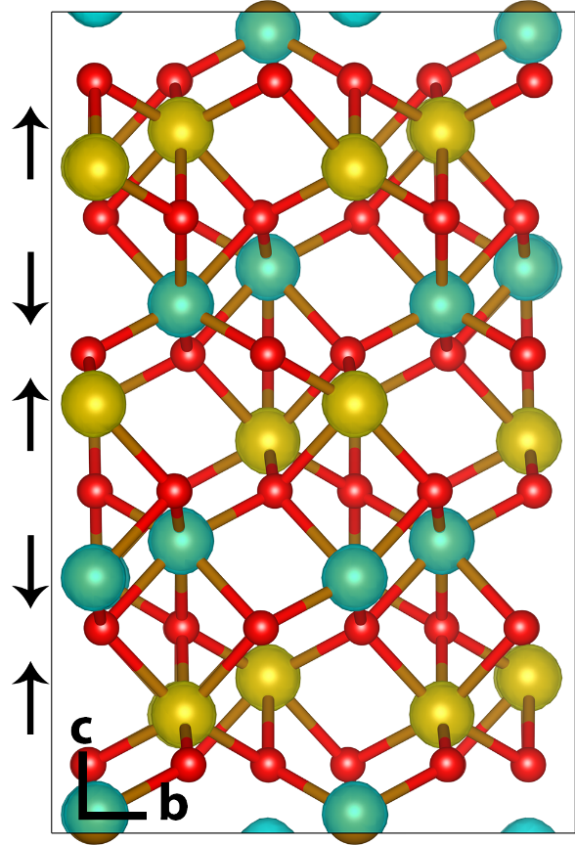
Motivation
Magnetic systems are common in nature (Fe, Ni, Co etc.)
Magnetic systems are typically more challenging and expensive to study

Slide 3
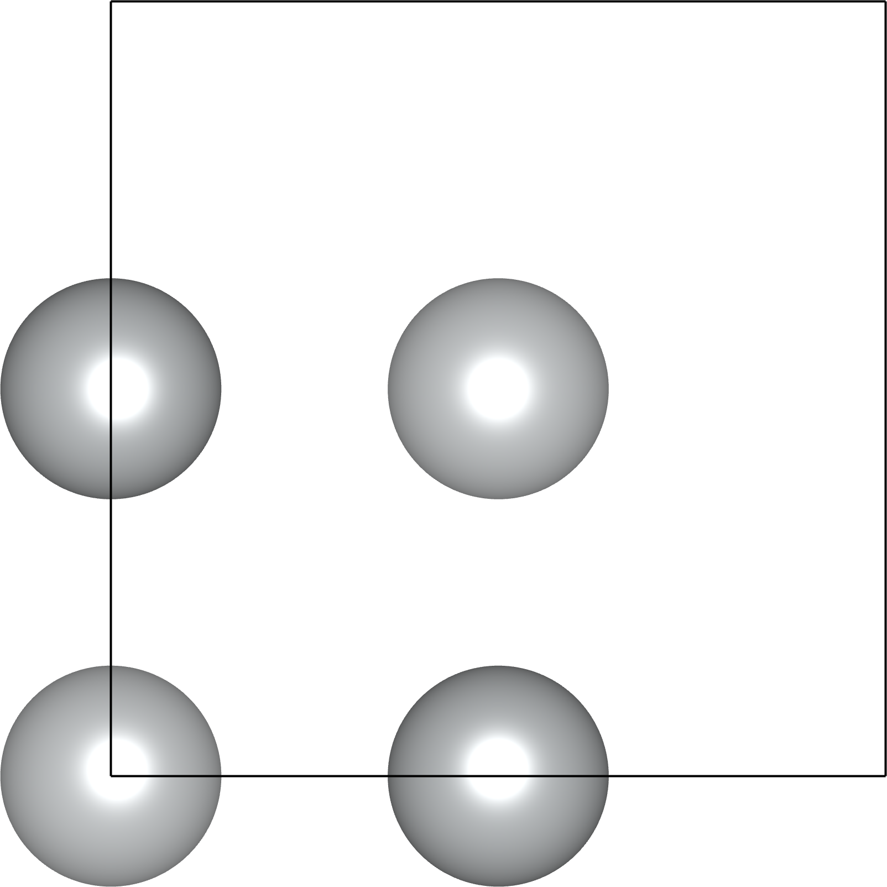
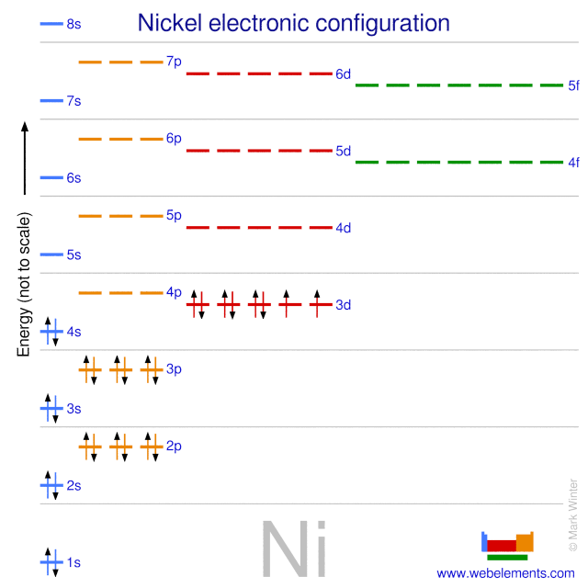
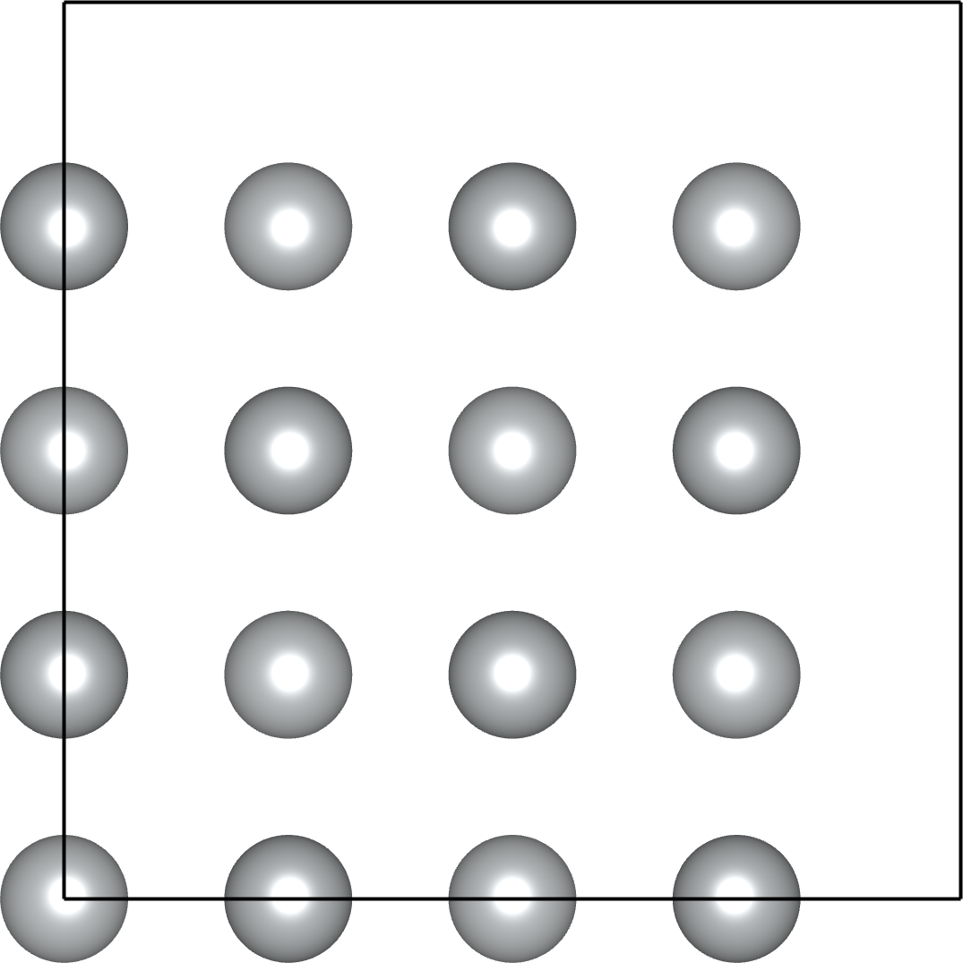
Bulk Ni
From electronic configuration [Ar] 3d⁸ 4s² Ni should be ferromagnetic
FCC unit cell
2x2x2 supercell

Slide 4
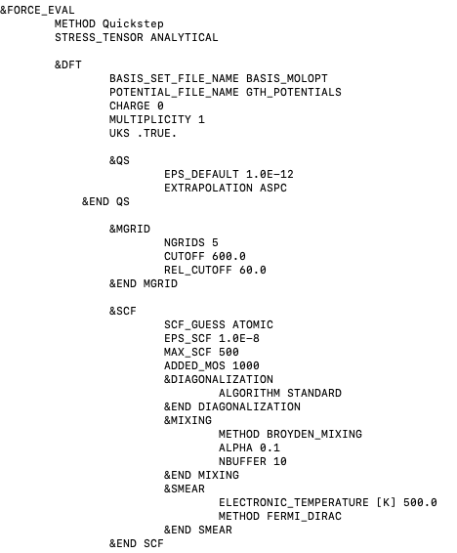
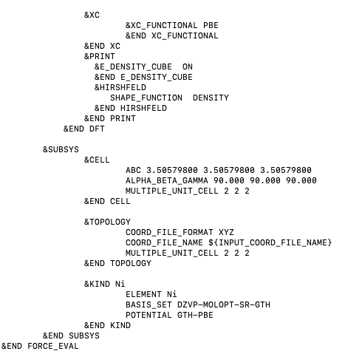
Bulk Ni
From electronic configuration [Ar] 3d⁸ 4s² Ni should be ferromagnetic
Consider a 2x2x2 supercell of Ni with 32 atoms and 576 electrons (32*18=576):
FCC unit cell
2x2x2 supercell

Slide 5
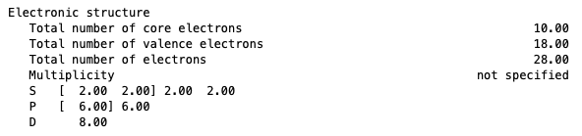
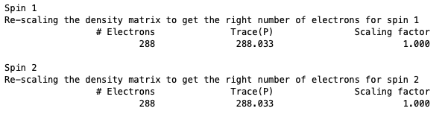
Bulk Ni: multiplicity 1
From electronic configuration [Ar] 3d⁸ 4s² Ni should be ferromagnetic
Consider a 2x2x2 supercell of Ni with 32 atoms and 576 electrons (32*18=576):

Slide 6
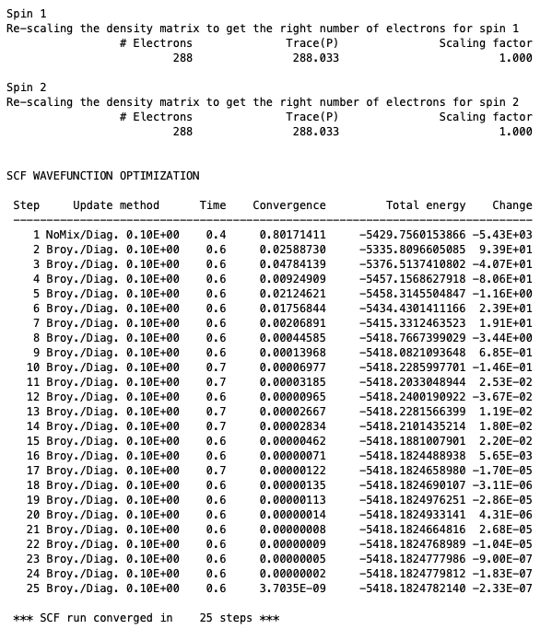
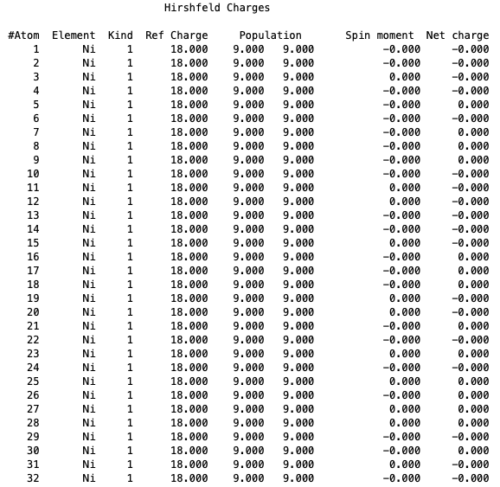
Bulk Ni: multiplicity 1
DFT SCF converges in 25 SCF steps and Hirshfeld analysis shows Ni spin moment of 0.00

Slide 7
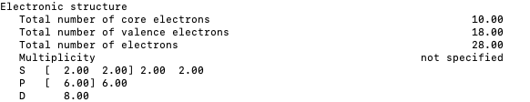
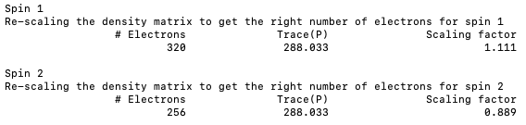
Bulk Ni: multiplicity 65
From electronic configuration [Ar] 3d⁸ 4s² Ni should be ferromagnetic
2 unpaired electrons per atom -> total multiplicity 2S+1: 2*2*1/2*32+1=65

Slide 8
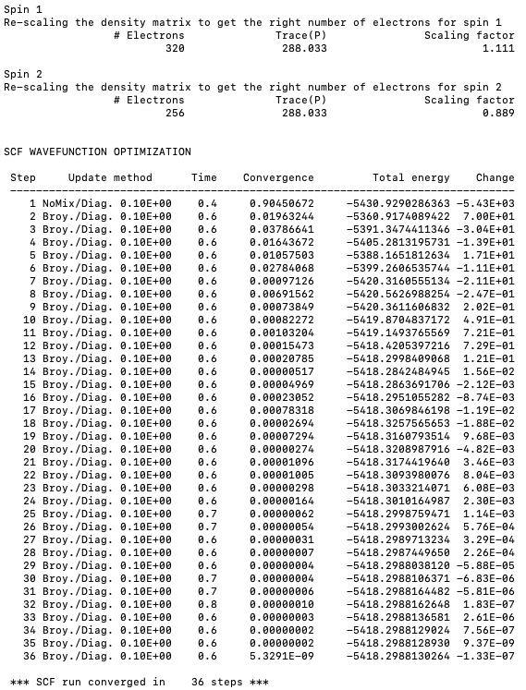
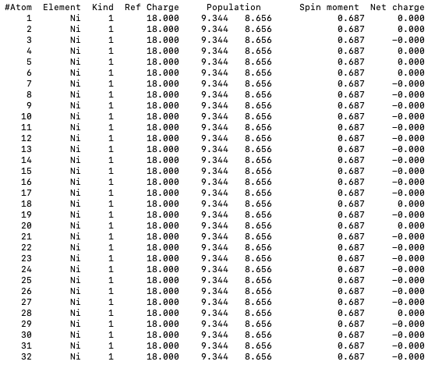
Bulk Ni: multiplicity 65
DFT SCF converges in 36 SCF steps and Hirshfeld analysis shows Ni spin moment of 0.69

Slide 9
Bulk Ni summary
Energy for bulk Ni is 3 eV lower with a ferromagnetic solution
Correct choice of multiplicity is essential to converge magnetic solution
Multiplicity | Energy / Ha | SCF steps | Spin moment
1 | -5418.1825 | 25 | 0.00
65 | -5418.2988 | 36 | 0.69
2x2x2 Ni supercell

Slide 10
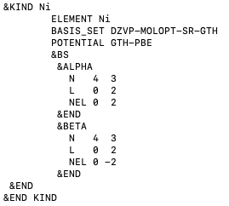
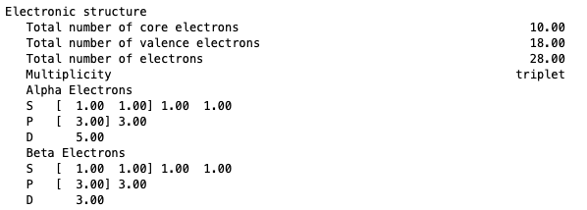
Improving the initial guess
&BS section defines the atomic orbital occupation assigned in initialization of the density matrix
N: Principal quantum number
L: Angular momentum quantum number
NEL: Orbital occupation number
2*2*0.5+1=3

Slide 11
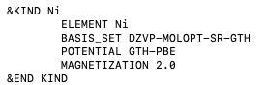
Improving the initial guess
Alternative to &BS section is MAGNETIZATION keyword

Slide 12
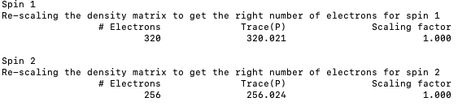
Improving the initial guess
Alternative to &BS section is MAGNETIZATION keyword

Slide 13
Bulk Ni summary
Energy for bulk Ni is 3 eV lower with a ferromagnetic solution
Multiplicity can be optimised with knowledge of calculated spin moment (starting guess s=0.5 is faster than s=1)
Multiplicity | Energy / Ha | SCF steps | Spin moment
1 | -5418.1825 | 25 | 0.00
65 (MAGNETIZATION 2) | -5418.2988 | 46 | 0.69
33 (MAGNETIZATION 1) | -5418.2988 | 23 | 0.69
2x2x2 Ni supercell

Slide 14
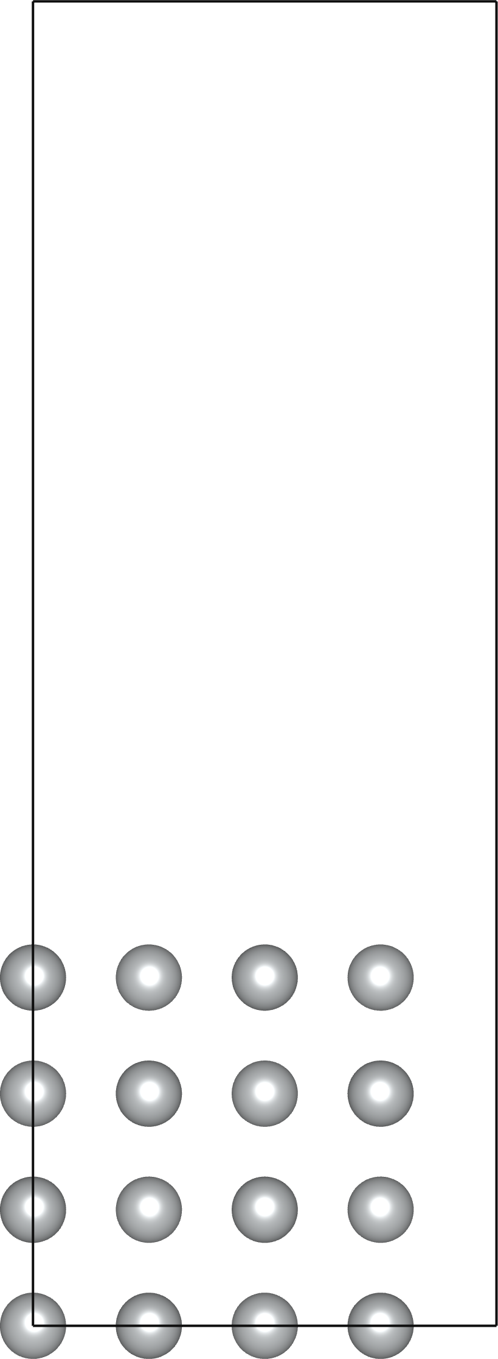
Ni slab in vacuum
Energy for Ni slab in vacuum is 2 eV lower with a ferromagnetic solution
SCF convergence is very slow (SCF steps shown for EPS_SCF: 1e-5, 1e-7)
Multiplicity | Energy / Ha | SCF steps | Spin moment
1 | -5417.5516 | 45, 73 | 0.00
65 (MAGNETIZATION 2) | -5414.6756 | 285, 374 | 0.68 bulk 0.74 interfacial
33 (MAGNETIZATION 1) | -5417.6242 | 564, 616 | 0.68 bulk 0.75 interfacial
2x2x2 Ni slab in vacuum

Slide 15
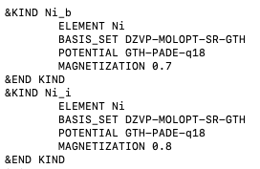
Improving the initial guess
Define MAGNETIZATION for each unique atomic environment
Choose non-integer magnetizations which sum to integer multiplicity (16*0.7+16*0.8)+1=25
Multiplicity | Energy / Ha | SCF steps | Spin moment
1 | -5417.5516 | 45, 73 | 0.00
65 (MAGNETIZATION 2) | -5414.6756 | 285, 374 | 0.68 bulk 0.74 interfacial
25 (MAGNETIZATION 0.7, 0.8) | -5414.6756 | 57, 139 | 0.68 bulk 0.74 interfacial
Ni_i
Ni_b
Ni_b
Ni_i
2x2x2 Ni slab in vacuum

Slide 16
General workflow
Converge bulk crystal with multiplicity according to Hund’s rule
Converge interface with multiplicity according to Hund’s rule
Define MAGNETIZATION for each unique atomic environment
Optimise MAGNETIZATION (float) consistently with MULTIPLICITY (integer)
Multiplicity | Energy / Ha | SCF steps | Spin moment
1 | -5417.5516 | 45, 73 | 0.00
65 (MAGNETIZATION 2) | -5414.6756 | 285, 374 | 0.68 bulk 0.74 interfacial
25 (MAGNETIZATION 0.7, 0.8) | -5414.6756 | 57, 139 | 0.68 bulk 0.74 interfacial
Ni_i
Ni_b
Ni_b
Ni_i
2x2x2 Ni slab in vacuum

Slide 17
Thank you for listening

Slide 18
Supporting Information

Slide 19
Bulk Ni
Defining MAGNETIZATION increases number of SCF steps for bulk Ni
Multiplicity 65, MAX_SCF 1
Multiplicity 65, MAX_SCF 1, MAGNETIZATION 2
Multiplicity 65, MAX_SCF 1
Multiplicity 65, MAX_SCF 1, MAGNETIZATION 1

Slide 20
Bulk Ni
Energy for bulk Ni is 3 eV lower with a ferromagnetic solution
Correct choice of multiplicity is essential to converge magnetic solution
&BS section or MAGNETIZATION lowers energy of first SCF step, however leads to slower convergence
Multiplicity | Energy / Ha | SCF steps | Spin moment
1 | -5418.1825 | 25 | 0.00
65 | -5418.2988 | 36 | 0.69
65 (MAGNETIZATION 2) | -5418.2988 | 46 | 0.69
33 | -5418.2988 | 19 | 0.69
33 (MAGNETIZATION 1) | -5418.2988 | 23 | 0.69
2x2x2 Ni supercell

Slide 21
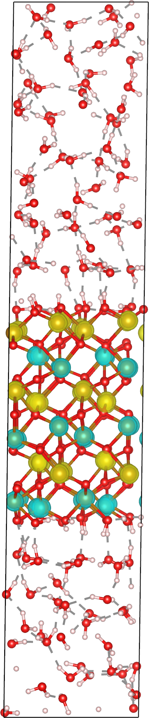
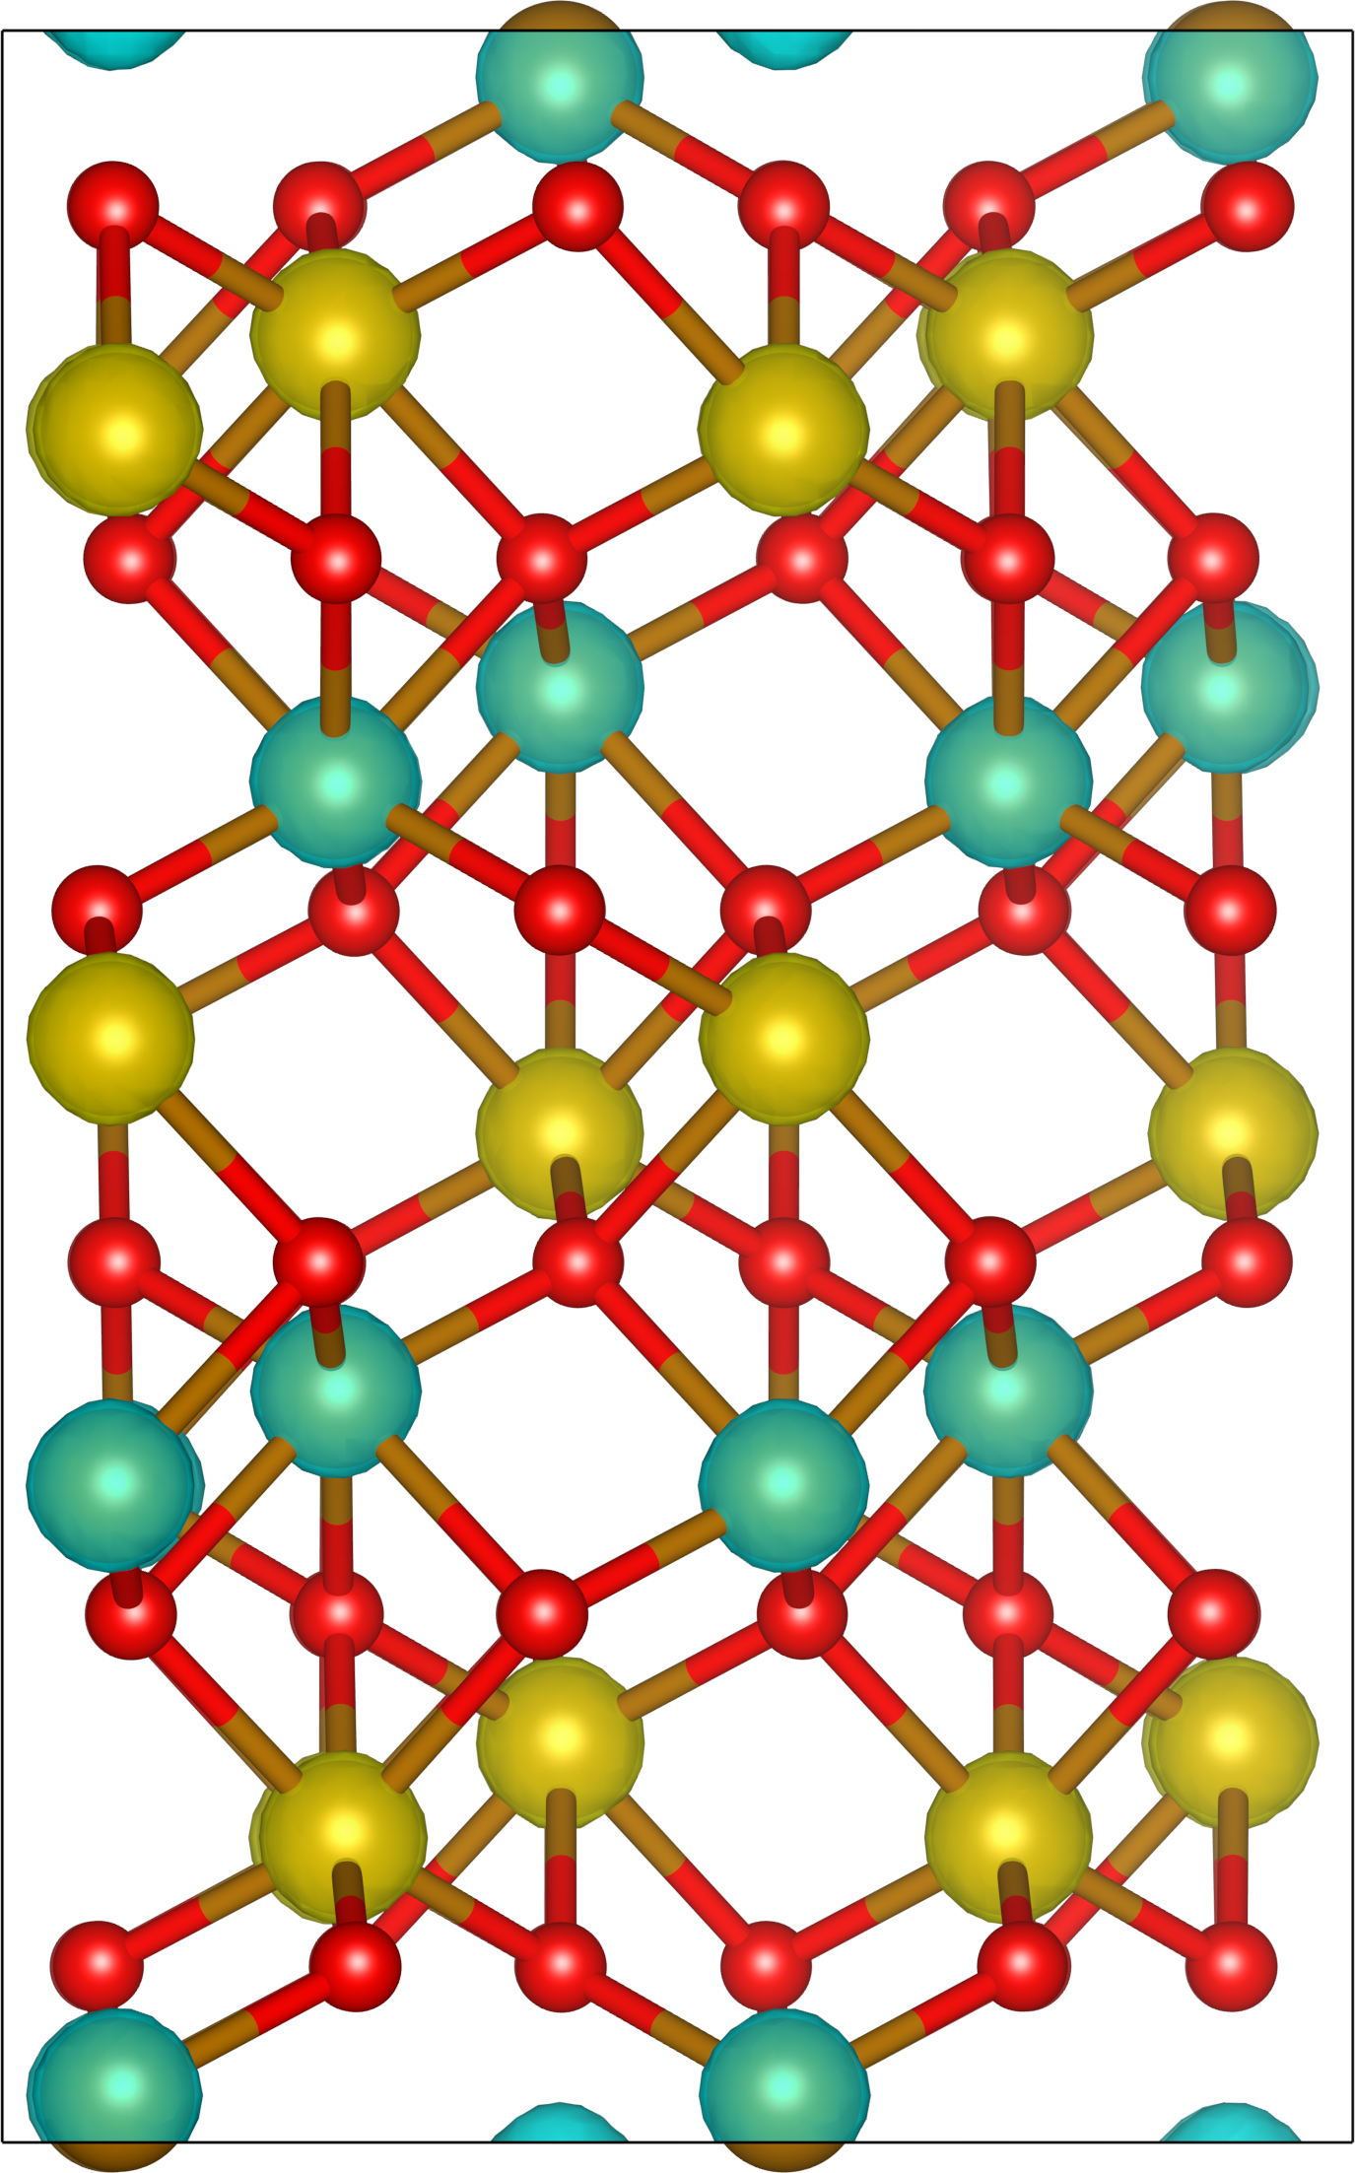
My background
PhD research involved converging antiferromagnetic iron oxides
No previous experience with Ni or pure metals

Slide 22
Lepidocrocite
Multiple magnetic solutions may exist for the same multiplicity, these must be checked manually
uudd -5623.8244 Ha
Spin moment 4.37 μ_{B}
udud -5623.8403 Ha
Spin moment 4.29 μ_{B}
uddu -5623.8383 Ha
Spin moment 4.29 μ_{B}

